Slide 1
Ctrl + Alt + Delineate

Slide 2
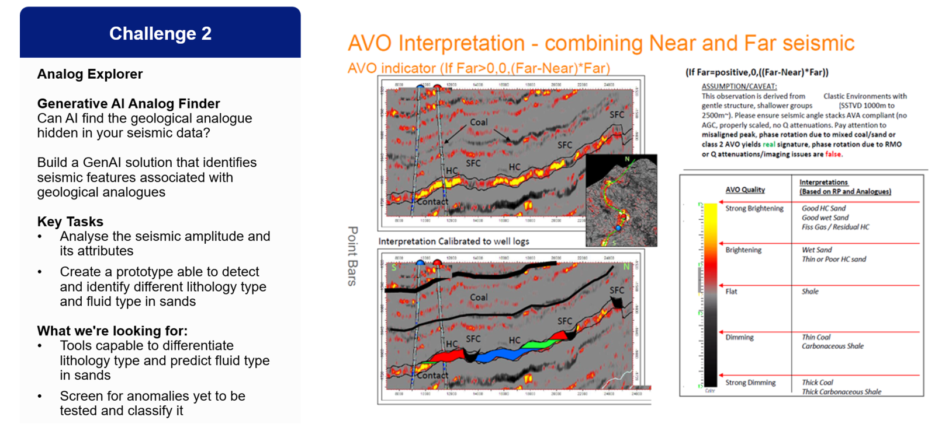
Challenge addressed: Challenge 2
Primary target: Predict the properties from seismic and its attributes.
+ Additional features…

Slide 3
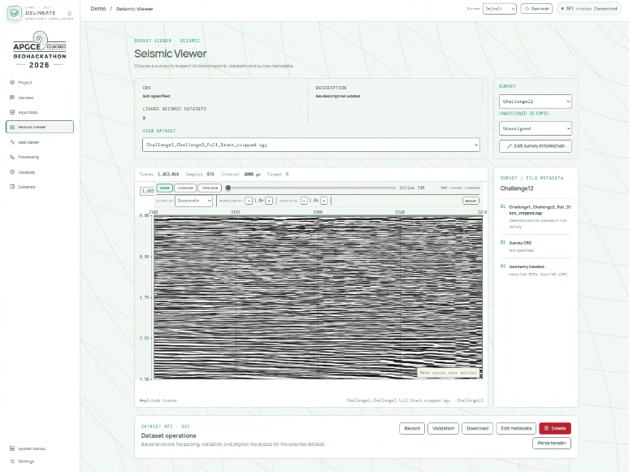
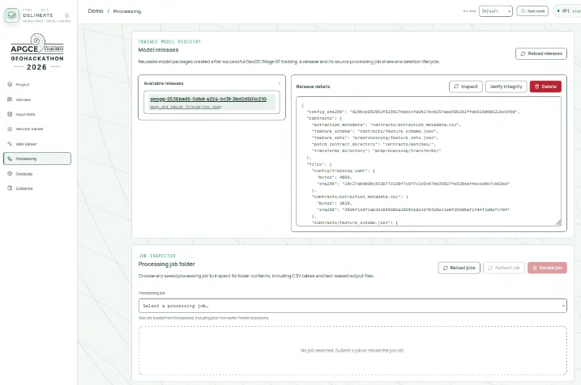
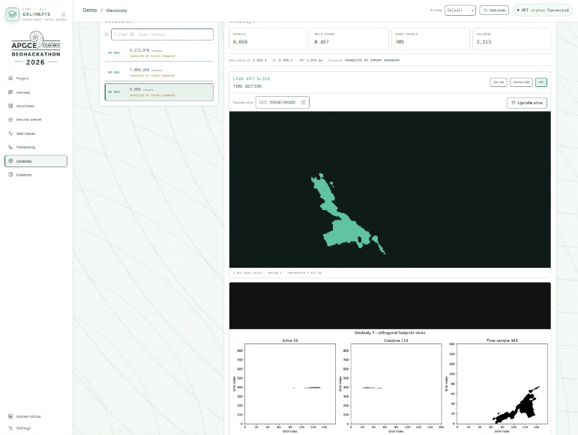
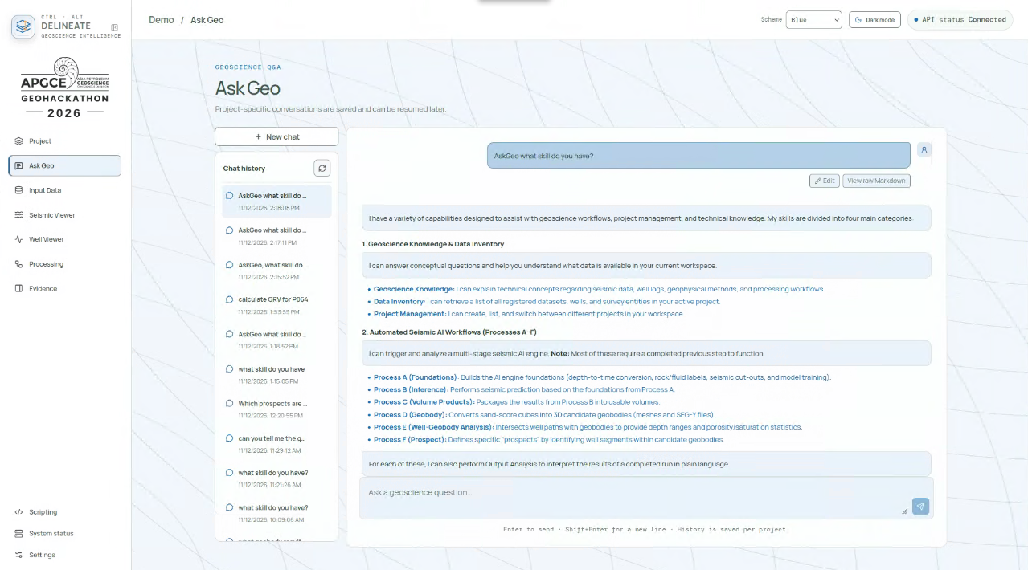
What we can do in our Apps
Data Viewer
AI-based Property Prediction
Geobody
extraction
Interactive System like ChatGPT

Slide 4
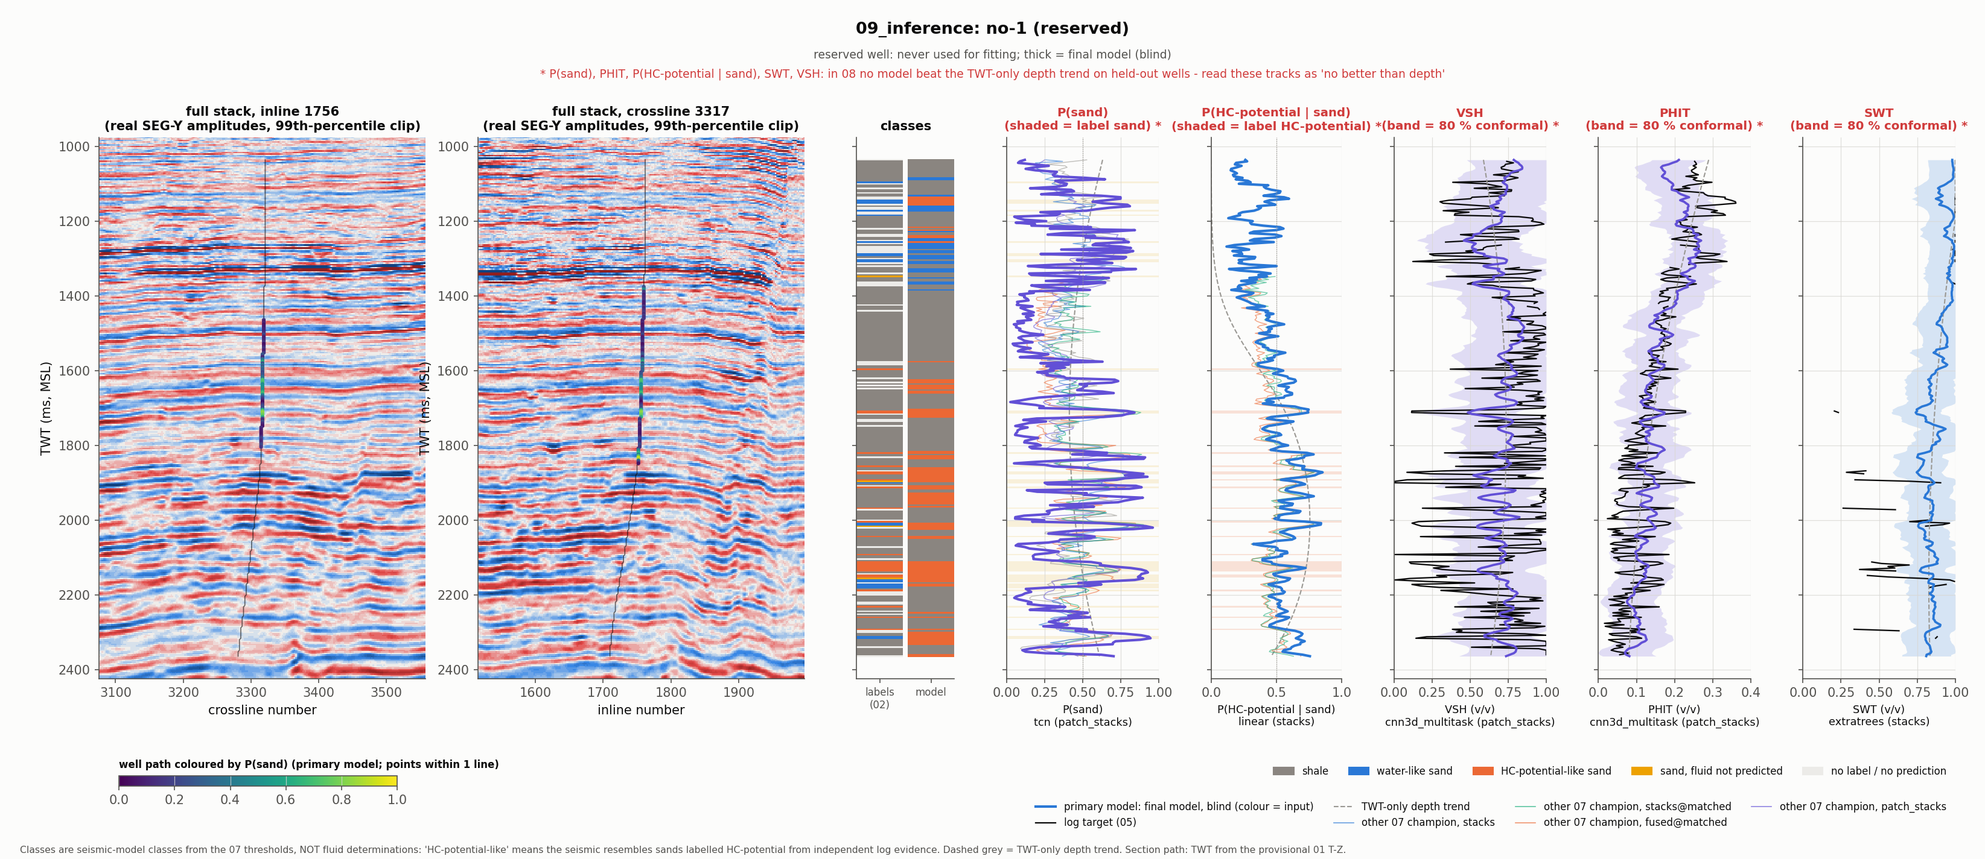
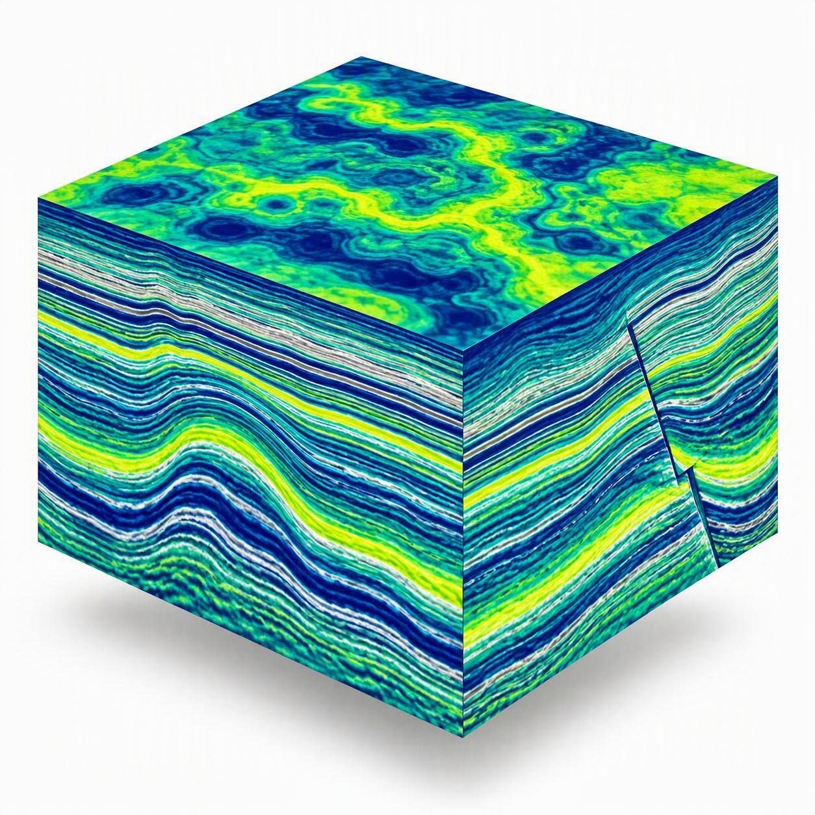
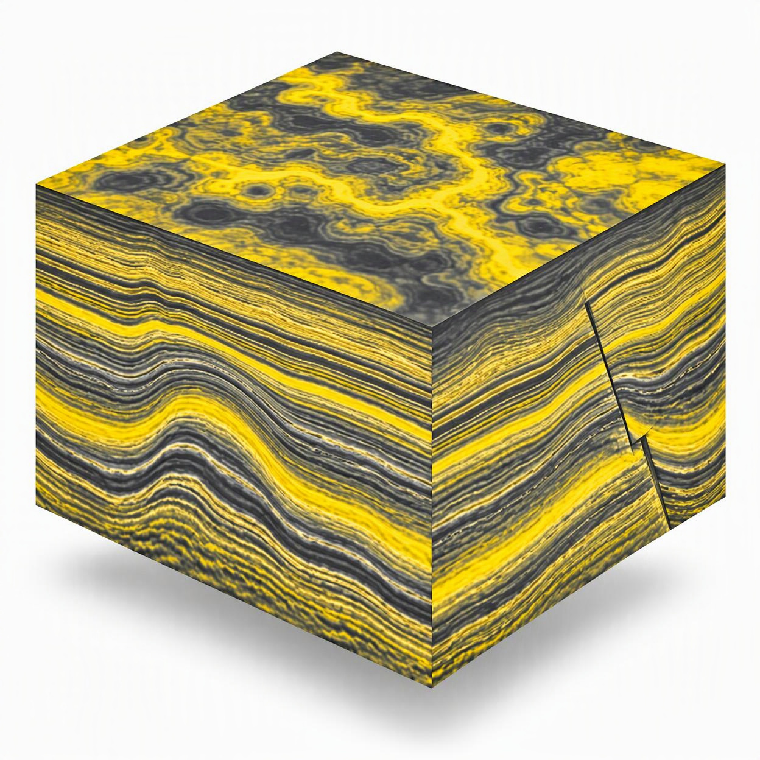
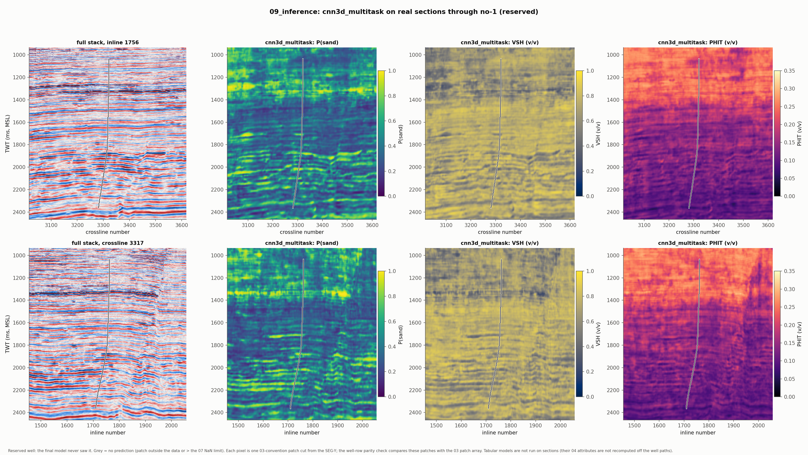
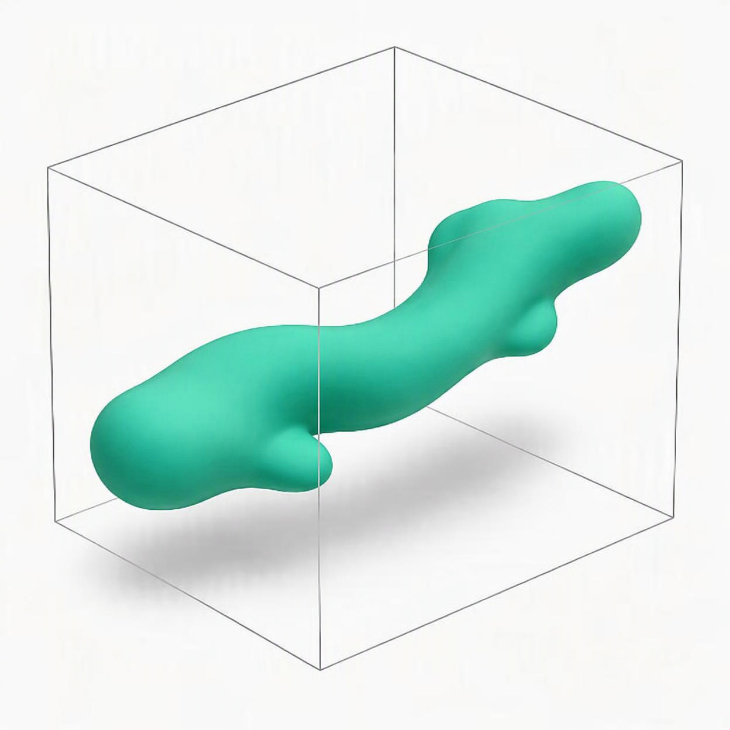
AI-based prediction: From Seismic to Reservoir Properties, and Geobody
Model Workflow
Seismic + well data
AI prediction
TCN , 3D CNN, ExtraTrees
Properties
Sand likelihood, VSH, PHIT, SWT
Geobody

Slide 5
Thank you
Integrated
Reproducible
Explainable
Data, viewers, and AI engine in a single workspace
Six linked stages with auditable evidence
Ask Geo answers in plain language; from the run’s own files

